Slide 1
Integration of Search, Social & Content in Europe
KEVIN GIBBONS
BLUEGLASS.CO.UK
@KEVGIBBO

Slide 2
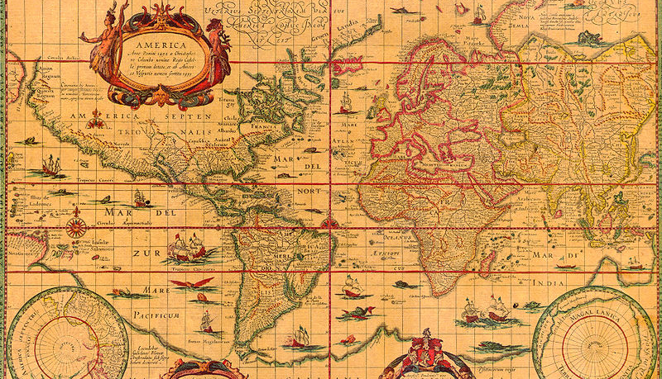
BlueGlass UK,
London, England
.
BlueGlass EMEA, Zürich, Switzerland
BlueGlass.co.uk
@BlueGlass
@KevGibbo

Slide 4
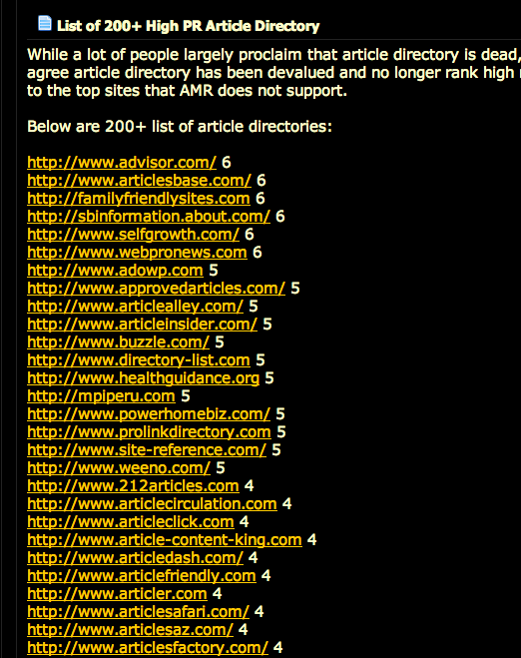
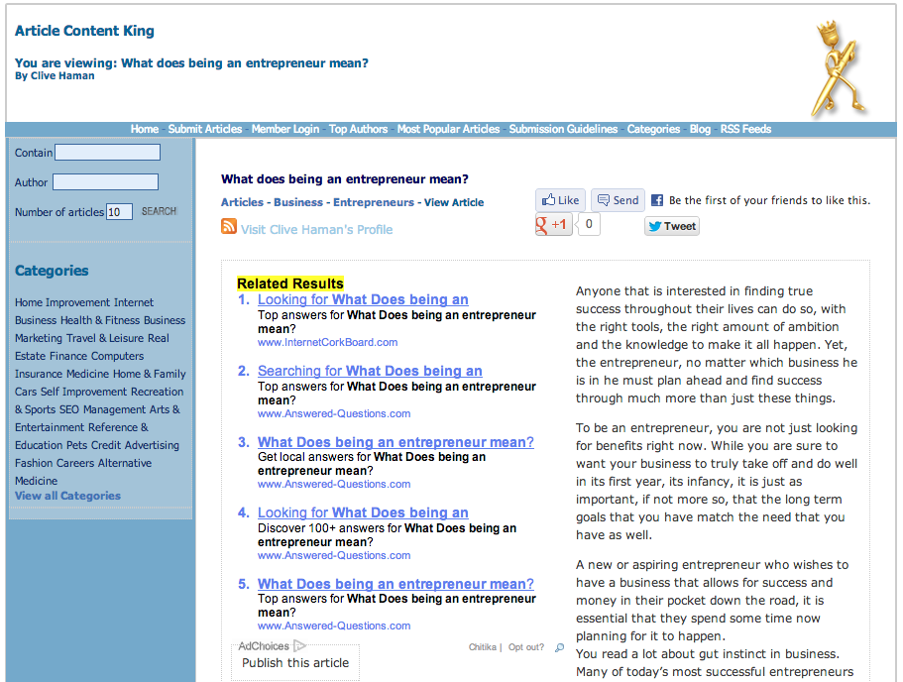
Google hates old-school link building

Slide 5
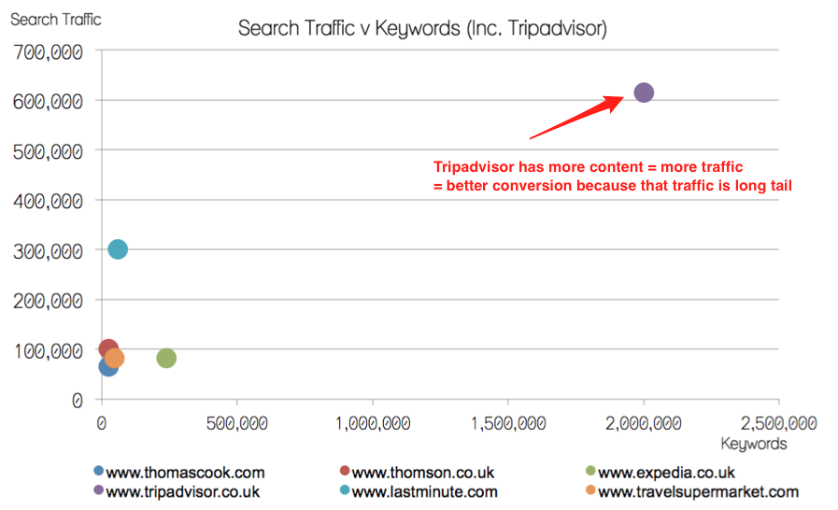
Scaled quality content works

Slide 6
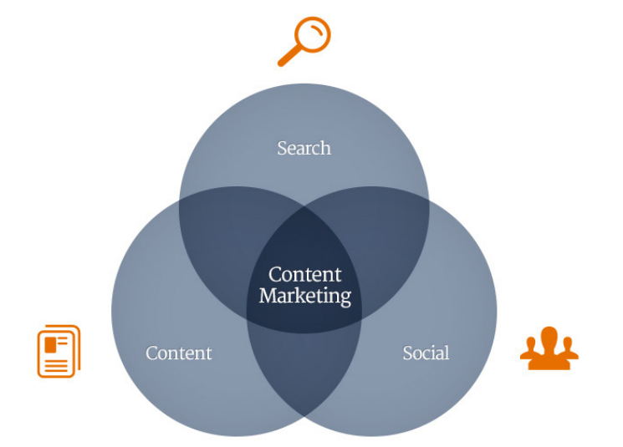
Make content the centre of your online strategy
http://www.copyblogger.com/content-marketing/

Slide 7
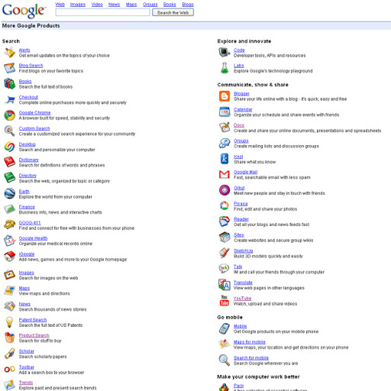
Google has more signals on quality than ever
Notes:
*Internal data*

Slide 8
Notes:
*Internal data*

Slide 9
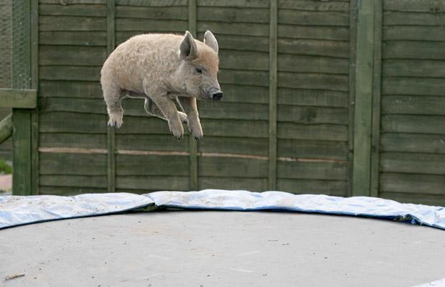
What users think of your site (bounce rate)
Notes:
*Internal data*

Slide 10
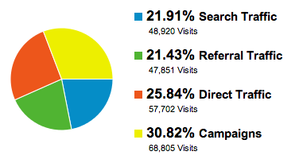
Where your traffic comes from (referrals)
Notes:
*Internal data*

Slide 11
Social signals & human engagement
Notes:
*Internal data*

Slide 12
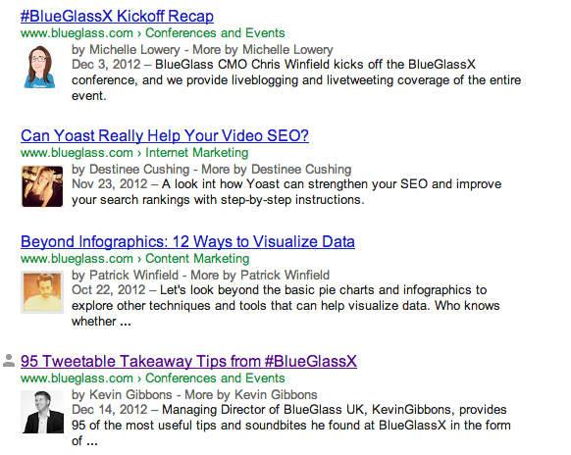
Your writers’ authority & influence
Notes:
*Internal data*

Slide 13
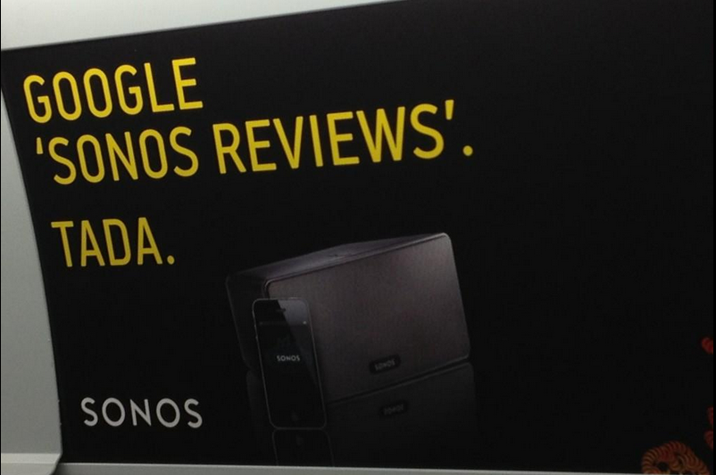
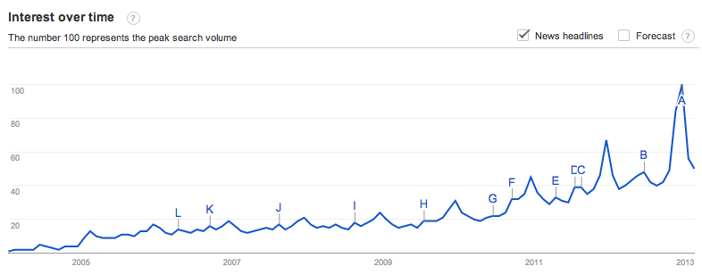
Your brand reputation
Notes:
*Internal data*

Slide 14
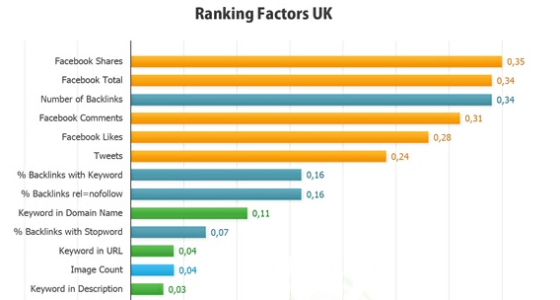
Which means it’s not just SEO anymore… It’s brand building!
http://www.searchmetrics.com/en/white-paper/google-ranking-factors-uk-2012/
Notes:
*Internal data*

Slide 15
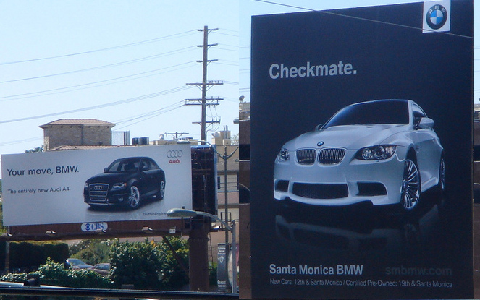
The best online content I’ve seen this year…
Notes:
*Internal data*

Slide 16
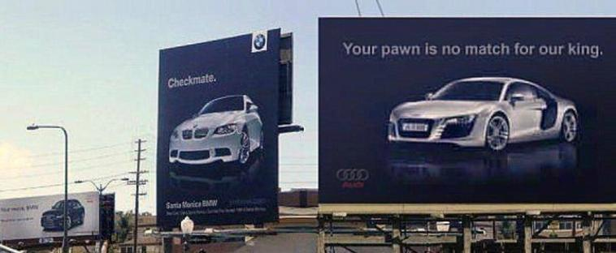
Is a billboard!
Notes:
*Internal data*

Slide 17
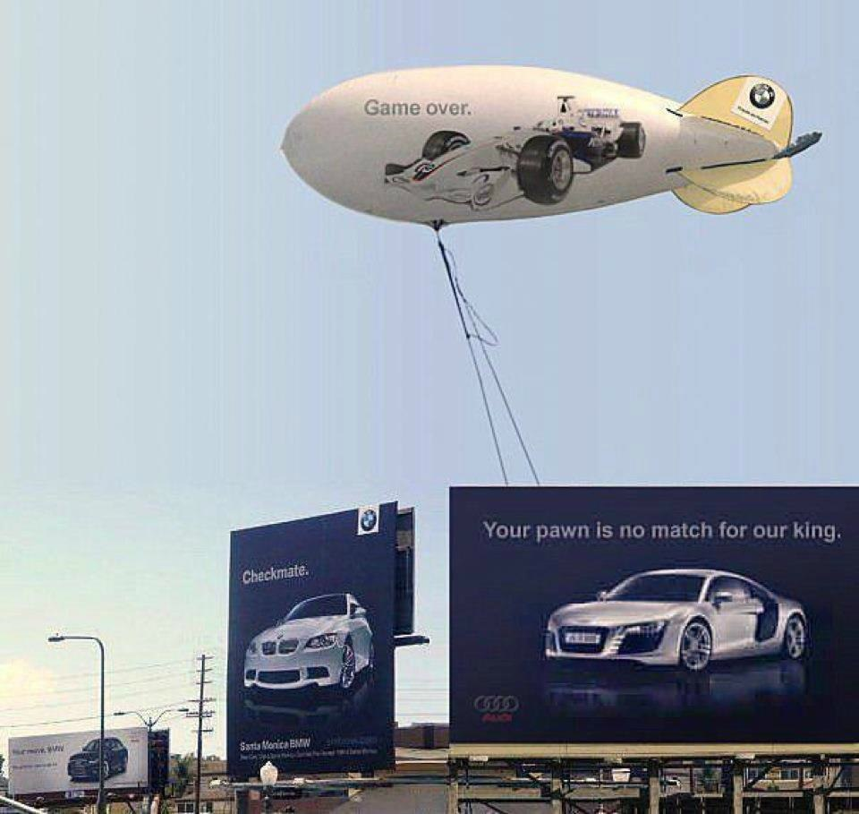
Think more agile!
Notes:
*Internal data*

Slide 18
Notes:
*Internal data*

Slide 19
Notes:
Outreach = logos for Mashable, Guardian, https://www.gov.uk/, http://www.coolest-gadgets.com/ Social Media = logos for Twitter, Facebook, Google +, Tumblr
Content Production = something like this: http://www.innovationsinnewspapers.com/wp/wp-content/uploads/2009/08/1.jpg
Paid Media = http://ceblog.s3.amazonaws.com/wp-content/uploads/2012/01/kisses_from_katie.png
SEO Strategy = http://imgur.com/OJu6033

Slide 20
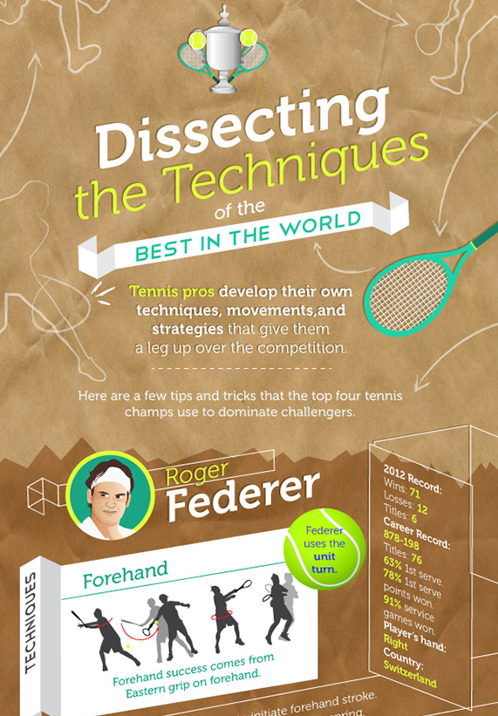
Organic visibility is still a great way to measure marketing success!
Editorial calendar around key events
50 natural links to target URL
215 Facebook likes, 62 Tweets
Drove “Australian Open Tennis Tickets” to #4 in Google

Slide 21
Notes:
*Internal data*

Slide 22
Be remarkable…
http://www.ted.com/talks/kid_president_i_think_we_all_need_a_pep_talk.html
Notes:
*Internal data*

Slide 23
Notes:
*Internal data*

Slide 24
For best outreach results, you need an audience – social media = likes/shares/retweets, but rarely links
Notes:
*Internal data*

Slide 25
How can you apply this across Europe?
@KevGibbo

Slide 26
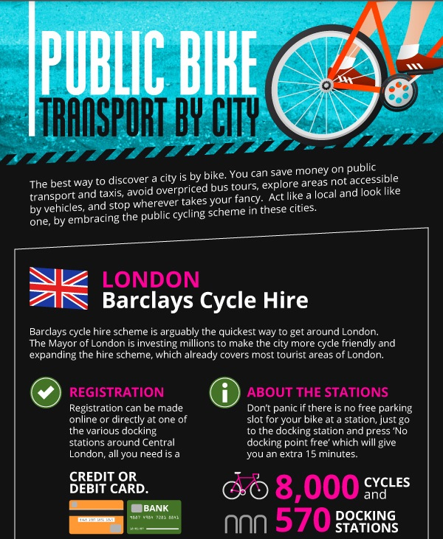
Translated & promoted infographic across 12 countries:
Generated high quality links & social shares from authority publications

Slide 27
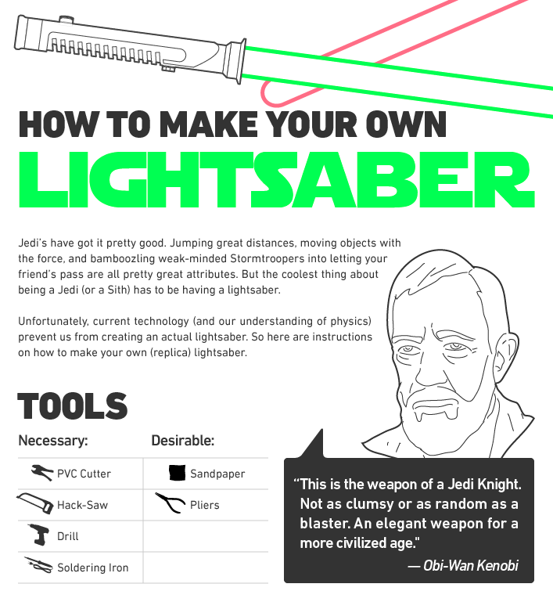
Promoted electronic components infographic
Acquired 100+ links/co-citations from 65 unique domains across 5 countries
http://fiz-x.com/how-to-make-a-lightsaber/

Slide 28
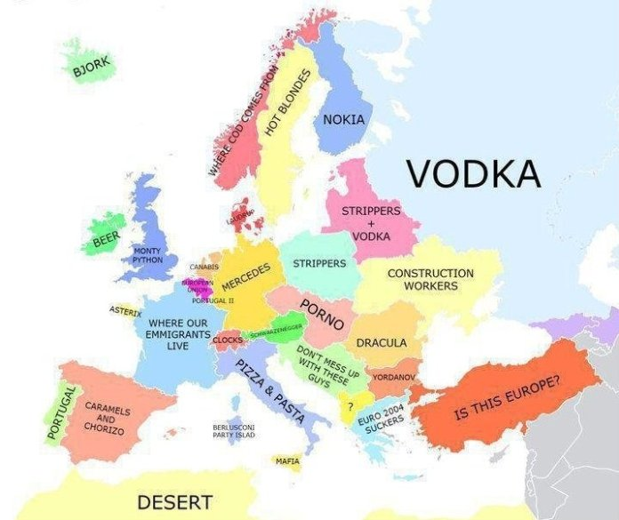
A one-fits all approach just doesn’t work – you need local expertise
Notes:
*Internal data*

Slide 29
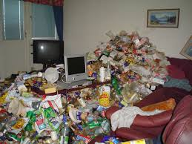
But without centralisation it looks like this!

Slide 30
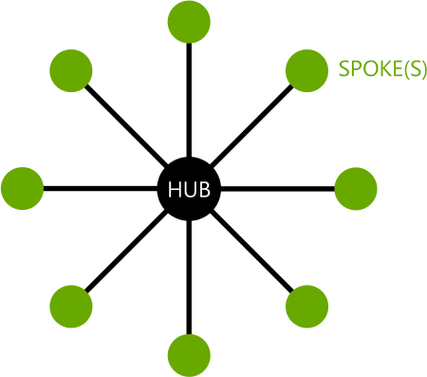
Centralised Strategy + Local Knowledge
= Best International SEO Success

Slide 31
Our International Learning's
@KevGibbo

Slide 32
Don’t wait – Algorithm changes often happen in English first, so use this to your advantage to be ahead of the game
BlueGlass.co.uk
@BlueGlass
@KevGibbo

Slide 33
It’s all relative - many languages/countries have very limited geographic reach
BlueGlass.co.uk
@BlueGlass
@KevGibbo

Slide 34
Low domain authority in smaller markets isn’t unusual, tailor content specifically to get more attention
BlueGlass.co.uk
@BlueGlass
@KevGibbo

Slide 35
Understand local behaviour & European holiday timetables
Notes:
*Internal data*

Slide 36
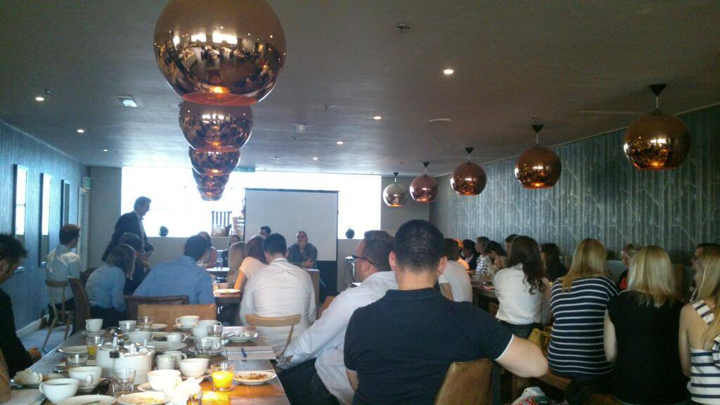
Outreach is much easier once you’ve built up personal relationships
Notes:
*Internal data*

Slide 37
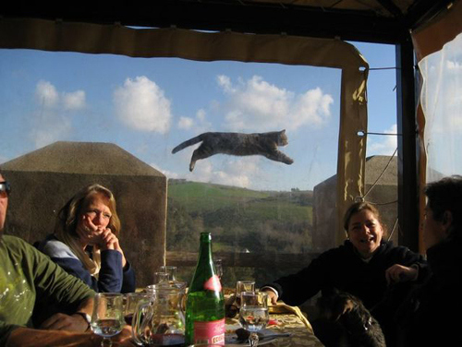
Timing is important – it all needs to line-up to avoid cross-over
Notes:
*Internal data*

Slide 38
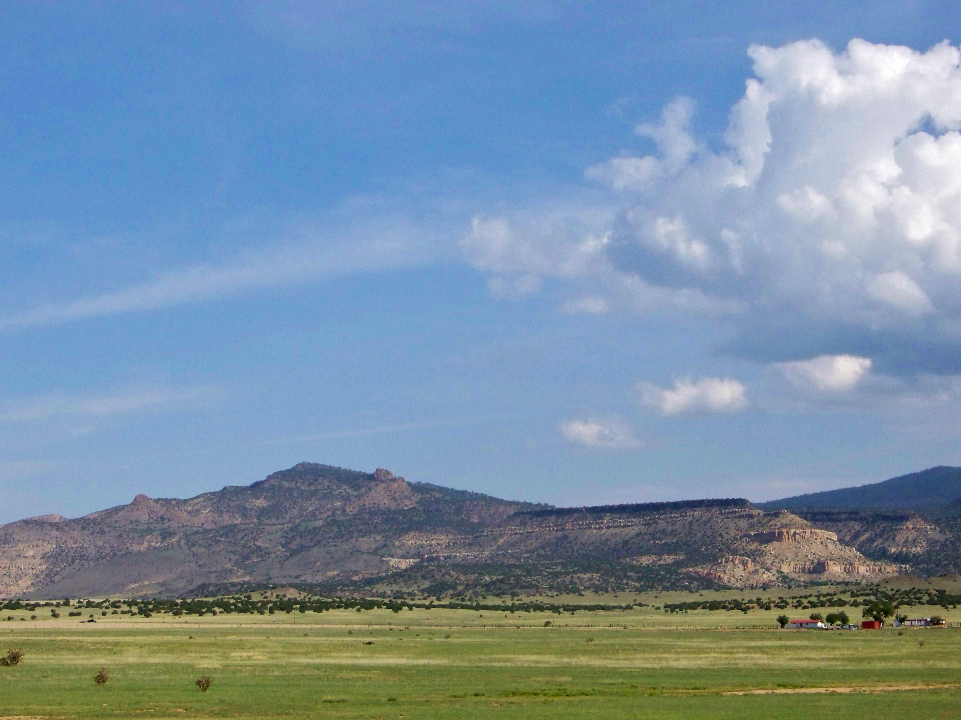
Share the love - HREFLANG can work very well, especially for lower populated countries
Notes:
*Internal data*

Slide 39
European Country Tips
@KevGibbo

Slide 40
Germany
Hobby bloggers or webmasters of non-commercial websites can be sceptical of outreach requests
Good opportunities when targeting other German speaking countries such as Austria and Switzerland
Target just a few websites and personally address them, explaining the benefit to their site to share your link
Content/emails must be written by a native speaker
German people are quite straight forward – just tell them what you want!
@KevGibbo

Slide 41
Russia
Yandex has market share – and traditional tactics can still work here, but build carefully, focusing on natural quality links if you can.
We’ve found Russian web users are often a young audience, take this into account when creating content for them.
Use native speakers for content and best outreach success.
BlueGlass.co.uk
@BlueGlass
@KevGibbo

Slide 42
Nordics
Scandinavia has different characteristics, however one theme runs through all of them; there is very limited resource and audience compared with other markets.
While most users are fluent in English, the personal angle & native language approach still works better
Put more focus on the leading authority publications
Lots of consumer protection laws around sending unsolicited emails, personal relationships work better
BlueGlass.co.uk
@BlueGlass
@KevGibbo

Slide 43
French
When approaching French speaking webmasters, only speak in French. Make sure your grammar is correct.
Co-branded content partnerships work much better than link exchanges for content – make it win, win!
BlueGlass.co.uk
@BlueGlass
@KevGibbo

Slide 44
Italian
Italian market is very small, which means you can need to measure quality relative to the individual market
Even Italian national media websites often have very average domain authority scores.
@KevGibbo

Slide 45
UK
Very commercially savvy in a range of market sectors
Building blogger relationships can be a long-process, but pays off long-term
Use exclusive data/research to gain access to authority sites and publications, creating content which shifts a niche’s standards or knowledge base
BlueGlass.co.uk
@BlueGlass
@KevGibbo

Slide 46
Notes:
*Internal data*

Slide 47
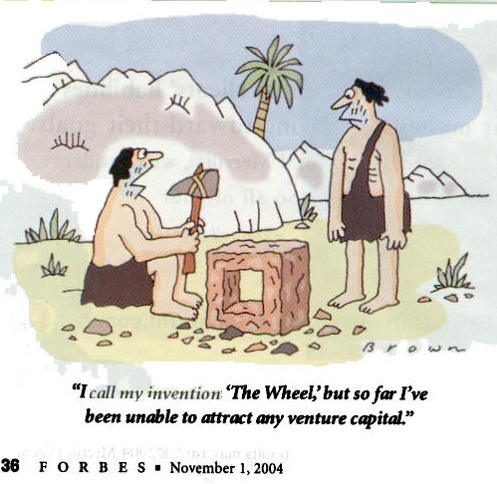
1) Understand the locals & use their expertise
Notes:
*Internal data*

Slide 48
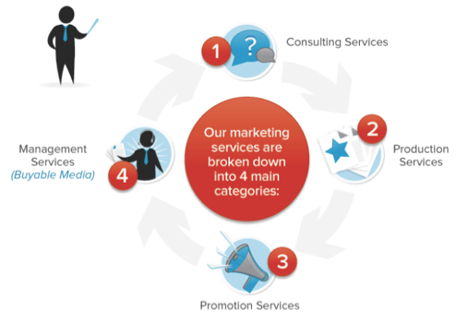
2) Centralise your strategy to keep track across all markets & get things done!
Notes:
*Internal data*

Slide 49
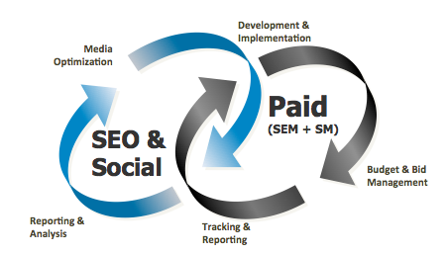
3) Integrate into a wider strategy with a range of expertise for full benefit

Slide 50
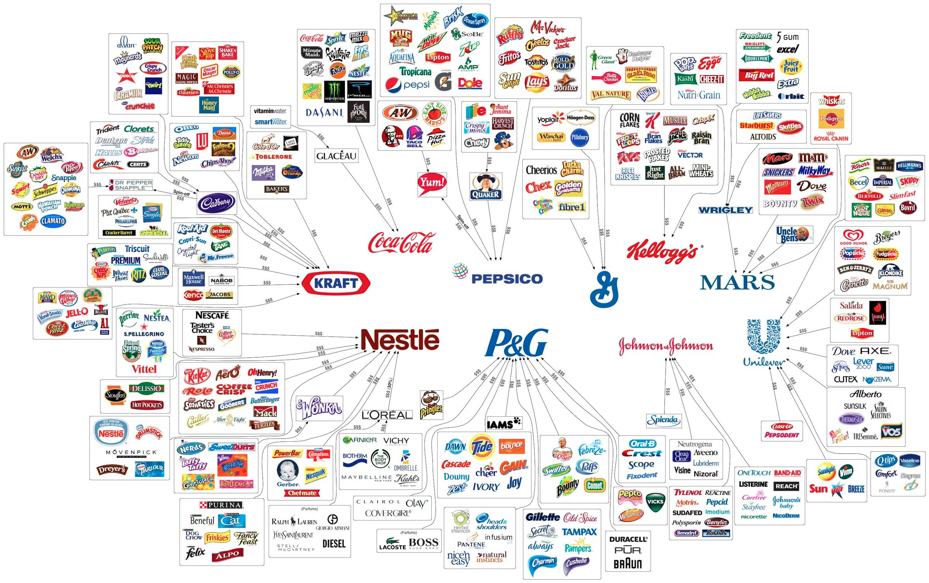
4) Send brand signals Google can’t ignore
http://www.dummies-for-destruction.co.uk/random/wp-content/who_owns_what.jpg
Notes:
*Internal data*

Slide 51
KEVIN GIBBONS
KGIBBONS@BLUEGLASS.CO.UK
@KEVGIBBO
BLUEGLASS.CO.UK

